Slide 1
iOS Week 4 Connectivity

Slide 2
Overview
External communication
Webservices
Saving user data in application
Hands-on: TableView

Slide 3
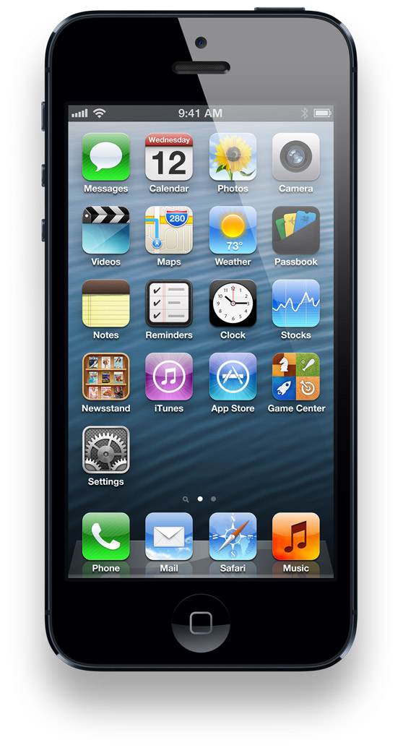
Notes:
Fast CPU, camera, 32gb storage , apps. But most importantly: Connected to the web.

Slide 4
External Communication
Server
Internet
Device
Notes:
Send or receive data from external server
This data is always up to date
This data is used for backups
By using external communication, offline processing power is used.
This is quicker, and saves the devices battery.
Cons are that the device needs to be connected to the Internet through 3G or WiFi

Slide 5
Webservices
Request <Data>
Server
Returns <Data>
Notes:
Send a data request to a webserver through POST or GET But PUT, SELECT DELETE etc can be used as well.
This can be done synchronous or asynchronous in the application
Webservice returns a response with the requested data
A good way to return data is as an JSON object

Slide 6

Requesting data
Synchronous is easy, but it ‘blocks’ the UI until the task is done.
Asynchronous is harder, instead of waiting for the task to finish you react on a method.
Notes:
Asynchronous is not THAT much harder. Just do you logic in another method and set the correct delegate

Slide 7
Returning data
Return more than just one data element
Webservice connections are (relatively) slow, so its better to send more data at once.
How can we store multiple data elements?
Name
Age
Adress
Favorite color

Slide 8

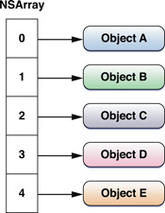
NSArray
NSString
NSnumber
NSString
Device
Server
Notes:
Array elements are index based. 0 is the first one, 1 the second etc.
But now the device and the server have to know which index contains which element.
What happens when another element is introduced? Or swapped? Or removed?

Slide 9
JSON Data
JavaScript Object Notation
Lightweight text based data exchange
Data stored as key/value pairs
Easily created in PHP
Easy to read/use into Objective-C
Slightly harder in Swift (for now)

Slide 10

Key/Value pairs
Structure
Key
Value
Examples
Name
Glenn
Color
Purple
Location
Space

Slide 11

Name
Color
Device
Location
Server

Slide 12
Alamofire
Library for HTTP Requests
Asynchronous requests
Easy to use with swift
See manual for installation instructions

Slide 13
Requesting data
func loadJsonData()
{
var jSONrequest = Alamofire.request(.GET, "http://athena.fhict.nl/users/i886625/pirates.json")
jSONrequest.validate()
jSONrequest.responseJSON
{ (urlREQ, urlResp, responsestring, error) -> Void in
if error == nil
{
println(responsestring)
self.parseJsonData(responsestring)
}
else
{
//Something went wrong
println(error)
}
}
}

Slide 14
Advanced Swift
Closures
http://fuckingswiftblocksyntax.com/
http://code.tutsplus.com/tutorials/swift-from-scratch-closures--cms-23138

Slide 15

Data handling
Comma indicates that
Another key/value pair will
follow
1 JSON Object
Indicates start of object
A value with value:
“Blackbeard (Edward Teach)”
A key with name: “name”
Key/value delimiter :
{
"name":"Blackbeard (Edward Teach)",
"life":"1680 - 1718",
"years_active":"1716 - 1718",
"country_of_origin":"England",
"comments":"With his fearsome appearance, Blackbeard is often credited with the creation of the stereotypical image of a pirate."
}
Indicates end of object

Slide 16
Data handling
Swift object (Pirate.swift)
import UIKit
class Pirate: NSObject {
var name:String?
var life:String?
var countryOfOrigin:String?
var comments:String?
}

Slide 17
Data handling
Multiple data objects
Indicates start of array
[
{
"name":"Blackbeard (Edward Teach)",
"life":"1680 - 1718",
"years_active":"1716 - 1718",
"country_of_origin":"England",
"comments":"With his fearsome appearance, Blackbeard is often credited with the creation of the stereotypical image of a pirate."
},
{
"name":"Edward England",
"life":"1690 - 1720",
"years_active":"1717 - 1720",
"country_of_origin":"Ireland",
"comments":"Differing from many other pirates of his day, England did not kill captives unless necessary."
},
{
"name":"William 'Captain' Kidd",
"life":"1645 - 1701",
"years_active":"1695 - 1699",
"country_of_origin":"Scotland",
"comments":"Although modern historians dispute the legitimacy of his trial and execution, the rumor of Captain Kidd's buried treasure has served only to build a legend around the man as a great pirate. His property was claimed by the crown and given to the Royal Hospital, Greenwich, by Queen Anne."
}
]
Indicates start of object
Indicates end of object.
, indicates that another object follows
Indicates end of array

Slide 18
Data handling
Array with pirates in Swift
//Create empty array for Pirates
var pirates = [Pirate]()
//Create a pirate
var piet = Pirate()
piet.name = "Piet"
piet.life = "1980 ->"
piet.comments = "Piet is quite boring"
piet.countryOfOrigin = "Belgium"
//Add it to the array
pirates.append(piet)

Slide 19

SwiftyJSON
Working with JSON in Swift is a load of !*Y^*%!^$#@*
For now
Luckily there is a nice library to fix this:
SwiftyJSON

Slide 20
Parse JSON
func parseJsonData(jsonData:AnyObject?)
{
//Create empty array for Pirates
var pirates = [Pirate]()
var jsonConverted = JSON(jsonData!)
println(jsonConverted)
for (index: String, subJson: JSON) in jsonConverted {
let newPirate = Pirate()
newPirate.name = subJson["name"].string
newPirate.comments = subJson["comments"].string
newPirate.life = subJson["life"].string
pirates.append(newPirate)
}
}

Slide 21
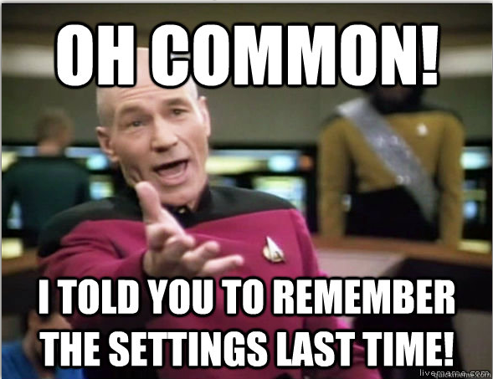
Saving data in app

Slide 22
Saving Data in Application
SQLite
Mini relational Database
Core Data
Data modeling based on SQLite
File IO
Hardcode file operations
NSUserDefaults
Key/value paired database in the App
Add, delete and update

Slide 23
NSUserDefaults
//Store value
NSUserDefaults.standardUserDefaults().setValue("Bert", forKey: "name")
//Read value
var name = NSUserDefaults.standardUserDefaults().stringForKey("name")
//Remove value
NSUserDefaults.standardUserDefaults().removeObjectForKey("name")
Notes:
Use the [preferences synchronize] call to sync the preferences with the internal app database.

Slide 24
NSUserDefaults
NSString
NSNumber
NSDate
NSArray
NSDictionary
NSData
Notes:
If you use Swift String, don’t forget to convert to NSString

Slide 25
Tableviews
A tableview is pretty dumb
It only shows what the controller tells it to show.
It doesn’t even know how many items it should show.
Actually it knows nothing!
So it delegates everything to the controller

Slide 26
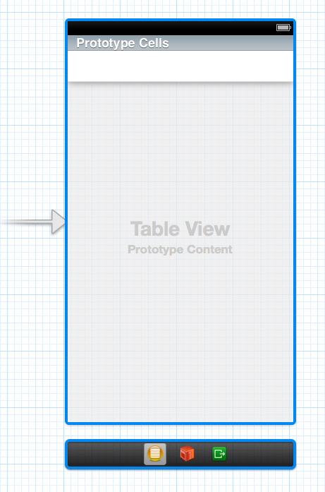
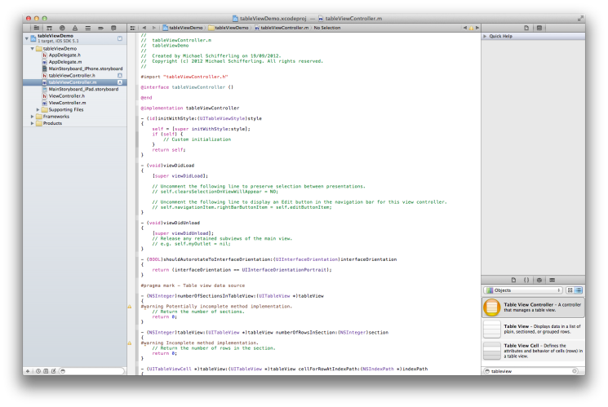
TableView
delegates
tableViewController

Slide 27
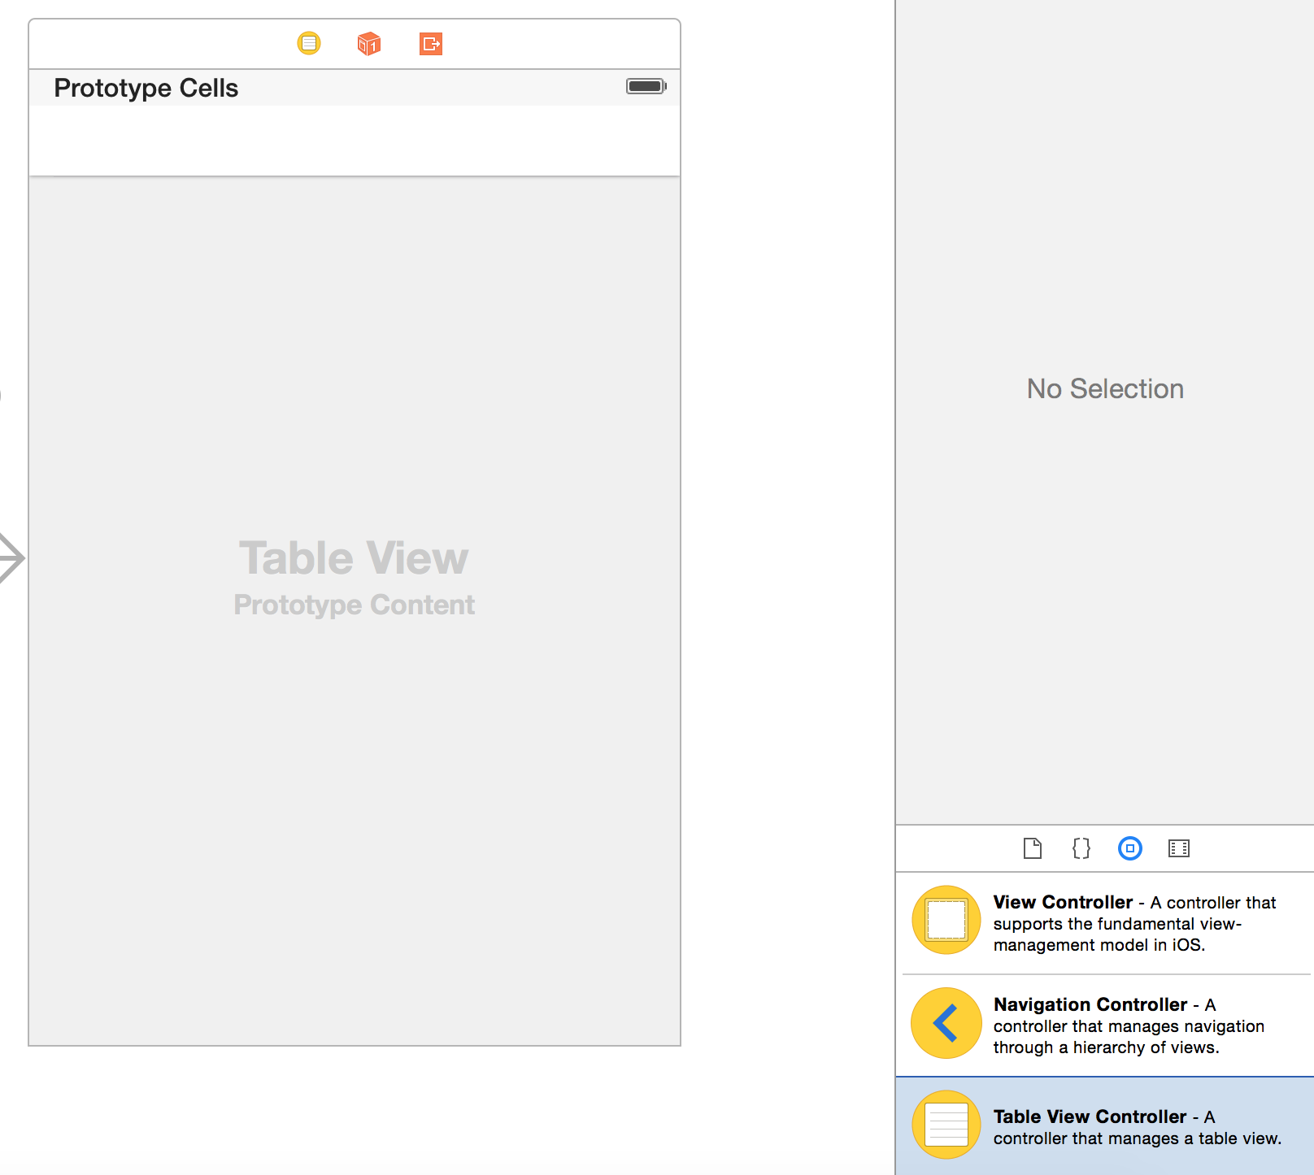
TableViews

Slide 28
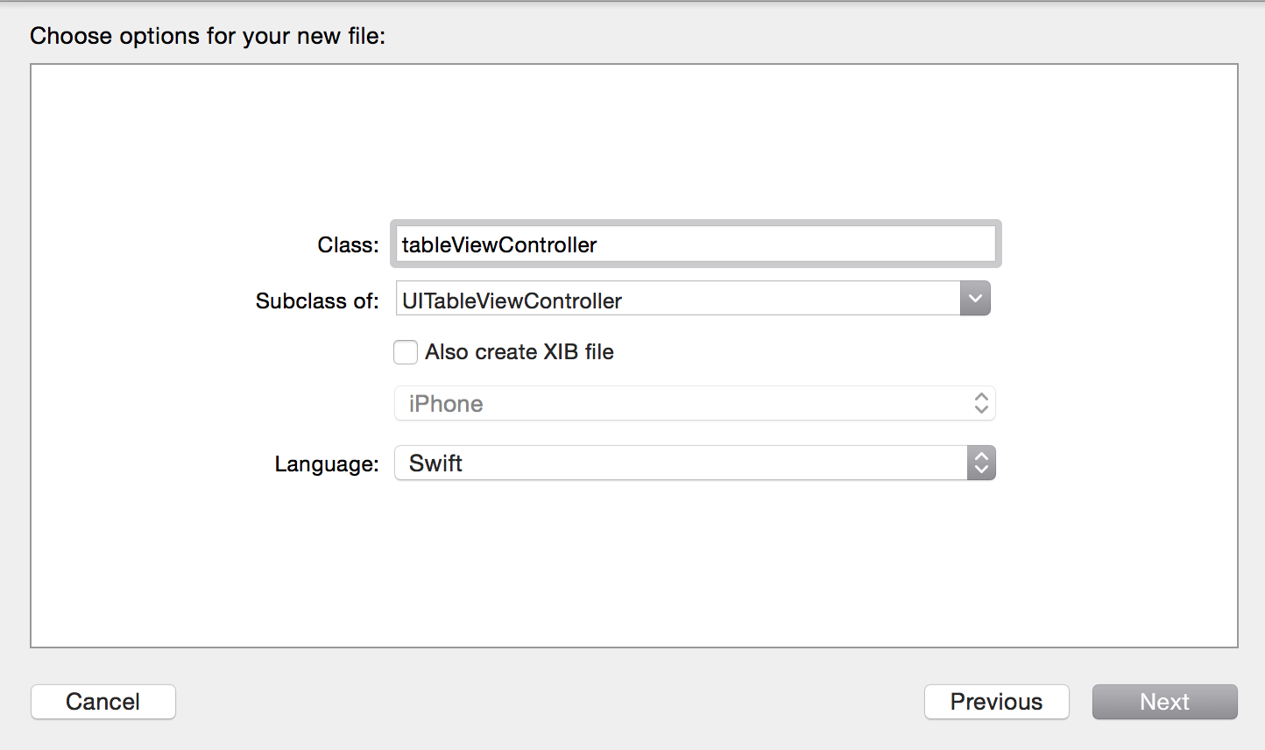
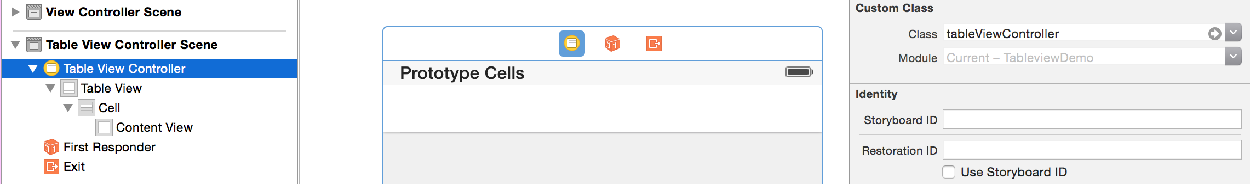
TableView

Slide 29
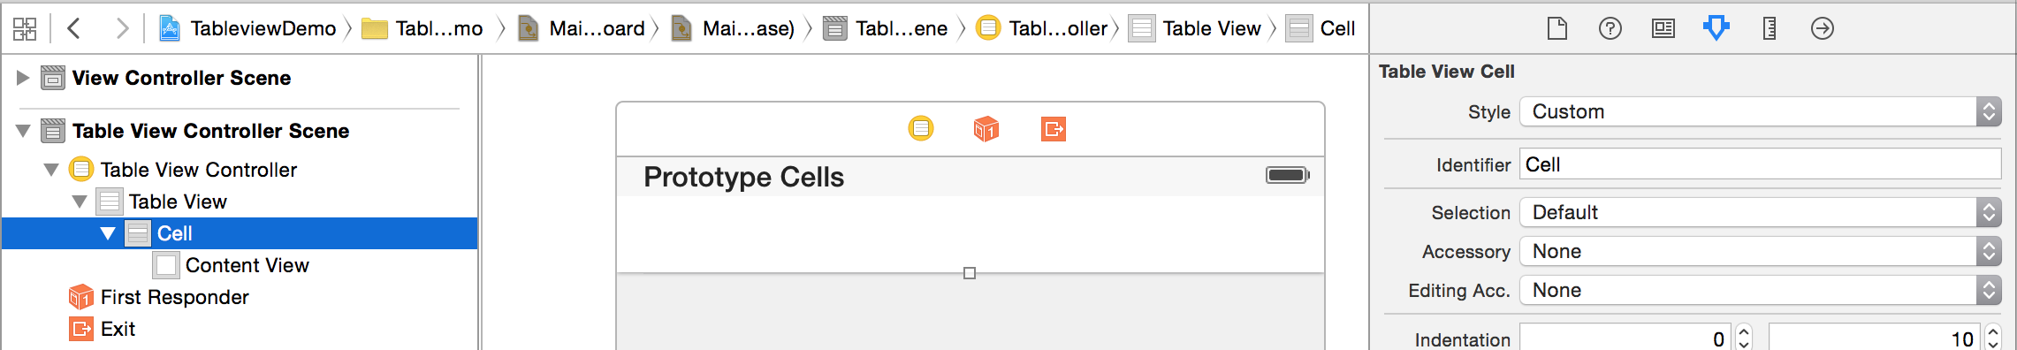
TableView

Slide 30
TableView
class tableViewController: UITableViewController {
var tableData: [String] = ["Pindakaas", "Fietsband","Hockeystick"]
override func numberOfSectionsInTableView(tableView: UITableView) -> Int {
// Return the number of sections.
return 1
}
override func tableView(tableView: UITableView, numberOfRowsInSection section: Int) -> Int {
// Return the number of rows in the section.
return tableData.count
}
override func tableView(tableView: UITableView, cellForRowAtIndexPath indexPath: NSIndexPath) -> UITableViewCell {
let cell = tableView.dequeueReusableCellWithIdentifier("Cell", forIndexPath: indexPath) as UITableViewCell
// Configure the cell...
cell.textLabel?.text = self.tableData[indexPath.item]
return cell
}
//More class stuff here...
}

Slide 31
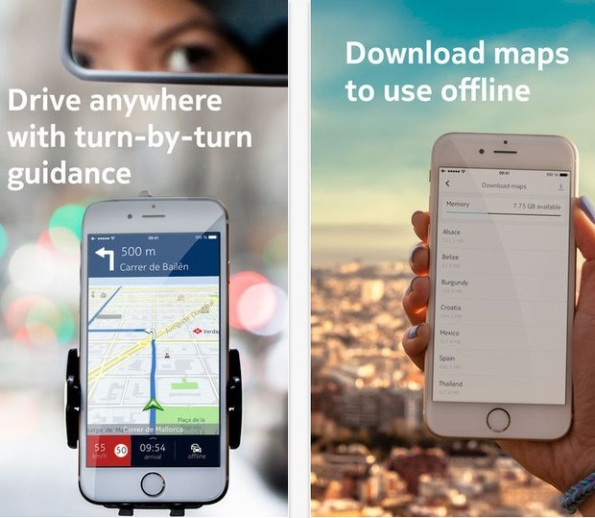
Hot in Mobile
Nokia brengt offlinenavigatie van Here Maps uit voor iPhones

Slide 32
Further Reading
Alomofire
https://github.com/Alamofire/Alamofire
JSON
https://github.com/SwiftyJSON/SwiftyJSON
NSUserDefaults
https://developer.apple.com/library/prerelease/ios/documentation/Cocoa/Reference/Foundation/Classes/NSUserDefaults_Class/index.html
NSDictionary
https://developer.apple.com/library/ios/documentation/Cocoa/Reference/Foundation/Classes/NSDictionary_Class/

